Slide 1
RTOS-Driven Industrial Security &
Performance Monitoring System
Using ESP32, IoT, and Machine Learning
K.MOHAMMED ZAHEER ( 950322106009 )
N.PARTHIBAN ( 950322106011 )
V.SAKTHI RAJA ( 950322106012 )
B.E.Electronics and Communication Engineering
FINAL YEAR
Academic Year: 2025-2026

Slide 2



Introduction
Modern industries demand real-time monitoring, safety, and efficiency. Traditional loop-based embedded systems fail to meet strict timing requirements for simultaneous critical tasks.
Industrial Automation
Real-Time Operating Systems
Safety & Security
Critical for safety, productivity,
and efficiency
Deterministic scheduling with priority execution
Prevent equipment damage and human injury
This project integrates RTOS task scheduling, IoT communication, and Machine
Learning to create an intelligent industrial monitoring system using ESP32.

Slide 3
Project Objectives
Design RTOS-based industrial monitoring system using ESP32
Ensure industrial security, safety, and reliability through real-time task scheduling
Monitor system performance: task execution time, CPU load, communication latency
Enable real-time data transmission using IoT protocols (MQTT/WebSocket)
Visualize live industrial data on mobile/web application
Analyze abnormal conditions using Machine Learning for predictive safety

Slide 4
Literature Review (1/3)
[1] Chandrasekaran, (2025) "RTOS Based Industrial Automation," i-manager's Journal on Embedded Systems
Proposed: OSA RTOS for industrial automation controlling temperature, PIR motion detection, and metal detection with context switching and multitasking capabilities.
[2] Trivedi and Vora, (2023) "Real-Time Monitoring and Control System for Industry," IJSRD
Proposed: ARM7-based system with Zigbee wireless communication for monitoring temperature, humidity, and pressure; includes GSM alerts and PC-based visualization.

Slide 5
Literature Review (2/3)
[3] Barrett (2023) "Real-Time Operating Systems: A Visual Simulator," ASEE Annual Conference
Proposed: Visual hardware simulator for teaching RTOS concepts with HCS12 microprocessor displaying status of 16 competing tasks using scheduling algorithms like RMS and EDF.
[4] Jose Sistus, (2022) "RTOS Based Device Control and Energy Monitoring System," IJARTET
Proposed: Small RTOS on LPC2148 with IEEE 802.15.4 protocol for collision-free data transmission; integrated IoT for environmental and energy monitoring with M2M communication.

Slide 6
Literature Review (3/3)
[5] Ahmad and Prabowo (2021) "Real Time Operating Systems for Embedded Applications: Design and Implementation," Journal of Integrated VLSI
Proposed: Comprehensive RTOS design patterns including task scheduling algorithms (RMS, EDF), interrupt handling optimization, and deterministic memory management techniques.
[6] Chaganty (2020) "Design & Development of Real-Time Multitasking Microkernel Based on ARM7TDMI," IJICA
Proposed: 32-task real-time microkernel on ARM7TDMI with OS functions for task creation, multitasking, scheduling, context switching, and inter-task communication.

Slide 7
Gap Analysis
Identified Gaps in Existing Research:
Lack of integrated systems combining RTOS, IoT, and ML in a single prototype.
Minimal focus on task-level performance monitoring (execution time, latency).
Limited real-time visualization of RTOS task behavior on mobile applications.
Most systems react to faults instead of predicting them.
These gaps highlight the need for a comprehensive RTOS-driven solution with integrated performance monitoring and predictive intelligence.

Slide 8




Novelty of Proposed System
Integrated Architecture
End-to-End Solution
FreeRTOS + IoT + ML in single system
ESP32 → IoT Protocol → Backend → Mobile App
Task Performance Monitoring
Predictive Intelligence
Real-time analysis of execution time and latency
ML-based anomaly detection and safety prediction

Slide 9
Existing System Architecture
Traditional Industrial Embedded Systems:
Sensors
Sequential
Processing
Manual
Monitoring
Delayed
Response
Limitations:
Loop-based programming with no task prioritization
High risk of system failure during heavy load
No predictive fault detection capabilities
Manual monitoring causes delayed intervention

Slide 10
Proposed System Architecture
Industrial
Sensors
ESP32
FreeRTOS
Tasks
IoT
Protocol
(MQTT)
Backend
Server
Mobile/Web
App
Machine Learning
Anomaly Detection
Key Features:
Priority-based task scheduling
Real-time performance monitoring
Predictive fault detection

Slide 11
Hardware Components
Controller
ESP32 DevKit
Sensors
HC-SR501 PIR Motion
Magnetic Door Sensor
MQ-2 Gas Sensor
KY-038 Noise Sensor
SW-420 Vibration Sensor
DS3231 RTC Module
Actuators
Buzzer - Audio Alert
Fan Relay - Cooling Control
Push Buttons
Indicators
LED Status Indicator
LED Alarm Indicator
LED Normal Operation
OLED Display
Component Roles
ESP32 + FreeRTOS
Central RTOS controller with Wi-Fi for IoT
PIR + Door Sensor
Unauthorized entry detection in restricted zones
MQ-2 Gas Sensor
Gas/smoke hazard detection and prevention
Relay + Fan
Automatic cooling and exhaust on thermal events
DS3231 RTC
Accurate timestamps for event logging

Slide 12
System Block Diagram
INPUT SENSORS
PIR Sensor
Magnetic Sensor
Gas Sensor
RTC Module
Noise Sensor
Vibration Sensor
ESP32
FreeRTOS
TASKS
Security Task
Safety Task
EmergencyTask
MonitorTask
CommTask
PerfTask
→
ACTUATORS
Buzzer / Siren
Fan Relay
LEDs
MOBILE / WEB
DASHBOARD
Live Sensor Data
Security Alerts
Safety Alerts
RTOS Metrics
ML Predictions
Alarm Control
Event History
→
IoT LAYER
Wi-Fi
MQTT Protocol
JSON Payload
→
→
ML ENGINE
Anomaly Detection
Isolation Forest
Prediction
→

Slide 13
Methodology
1
PHASE 1: Hardware Setup
Connect all sensors and actuators to ESP32 on breadboard
2
PHASE 2: RTOS Firmware
Design priority-based FreeRTOS task architecture
3
PHASE 3: Trace Hooks
Integrate FreeRTOS trace hooks for performance metrics
4
PHASE 4: IoT & App
Build MQTT pipeline and mobile/web dashboard app
5
PHASE 5: ML Integration
Train Isolation Forest on sensor data for anomaly detection
6
PHASE 6: Testing & Validation
Stress-test with simultaneous events; measure latency
Tools: ESP-IDF (FreeRTOS) | Python (ML/Backend) | MQTT Broker | React / Flutter (Dashboard) | Breadboard

Slide 14
Machine Learning Logic
Anomaly Detection Pipeline (Isolation Forest Algorithm)
Data Collection
Sensors stream via MQTT
Feature Extraction
Temp, gas, motion vectors
Model Inference
Isolation Forest scoring
Decision Output
Alert / Normal / Warn
RTOS Action
Trigger Task + Alert
→
→
→
→
Input Features
Temperature reading (C)
Gas concentration (ppm)
Motion count per minute
Vibration amplitude (mV)
Noise level (dB)
CPU utilization (%)
Task execution latency (ms)
Model Details
Algorithm: Isolation Forest
Training: Normal operation logs
Framework: Python scikit-learn
Output: Anomaly score (-1 or 1)
Accuracy: Target 92%+
Deployment: Backend server / edge
Alert Categories
Normal (Score = 1)
No action required; dashboard green
Warning (0 to -0.5)
Log event; increase monitoring freq
Anomaly (Score = -1)
Trigger RTOS EmergencyTask + App alert

Slide 15
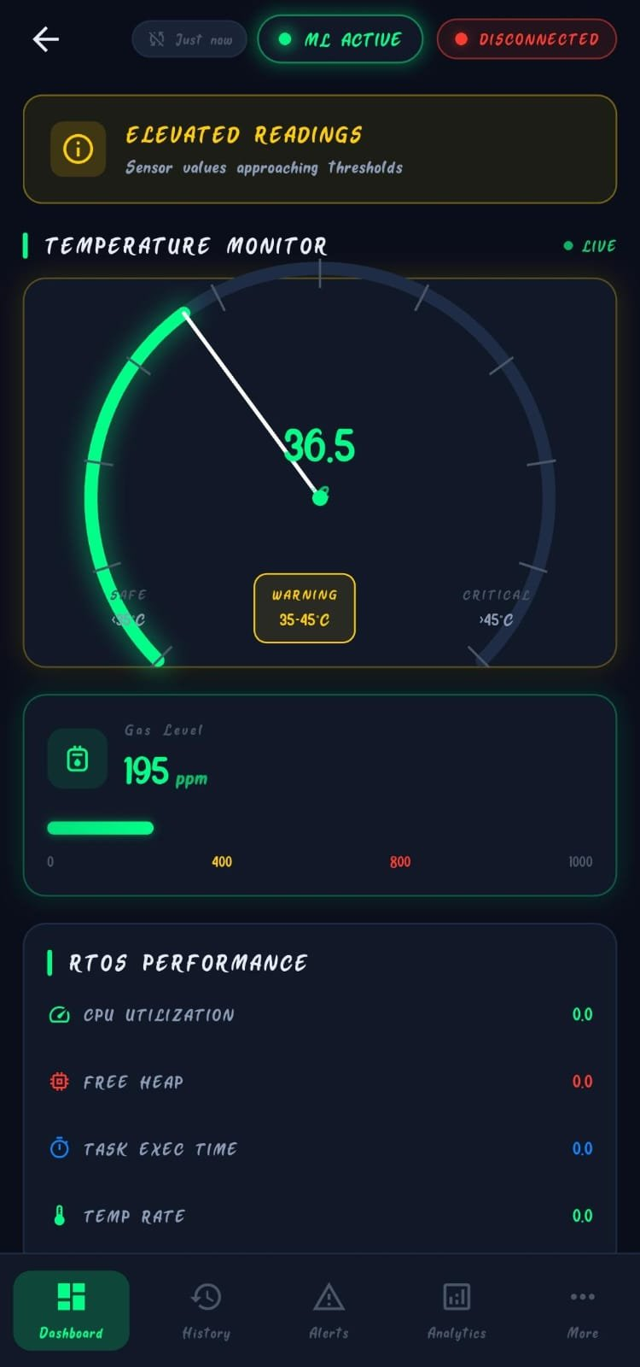
Mobile Application Architecture
Flutter + Riverpod + Hive | Real-time WebSocket + ML Inference
Presentation Layer (UI)
Dashboard | History | Alerts | Analytics | Settings
Flutter / Dart Cross-platform mobile framework
Riverpod Reactive state management
↓
State Management (Riverpod)
Providers | Notifiers | State Watchers
Hive Flutter Local storage for sensor history
WebSocket Real-time ESP32 communication
↓
Domain Layer (Business Logic)
ML Service | Alert Logic | Performance Tracker
ML Service (Dart) Isolation Forest inference on-device
↓
Boot Controller App lifecycle + performance tracker
Data Layer (Storage + Comms)
Hive (local) | WebSocket | Repository
5 Screens: Dashboard | Analytics | Event History | System Status | Configuration

Slide 16
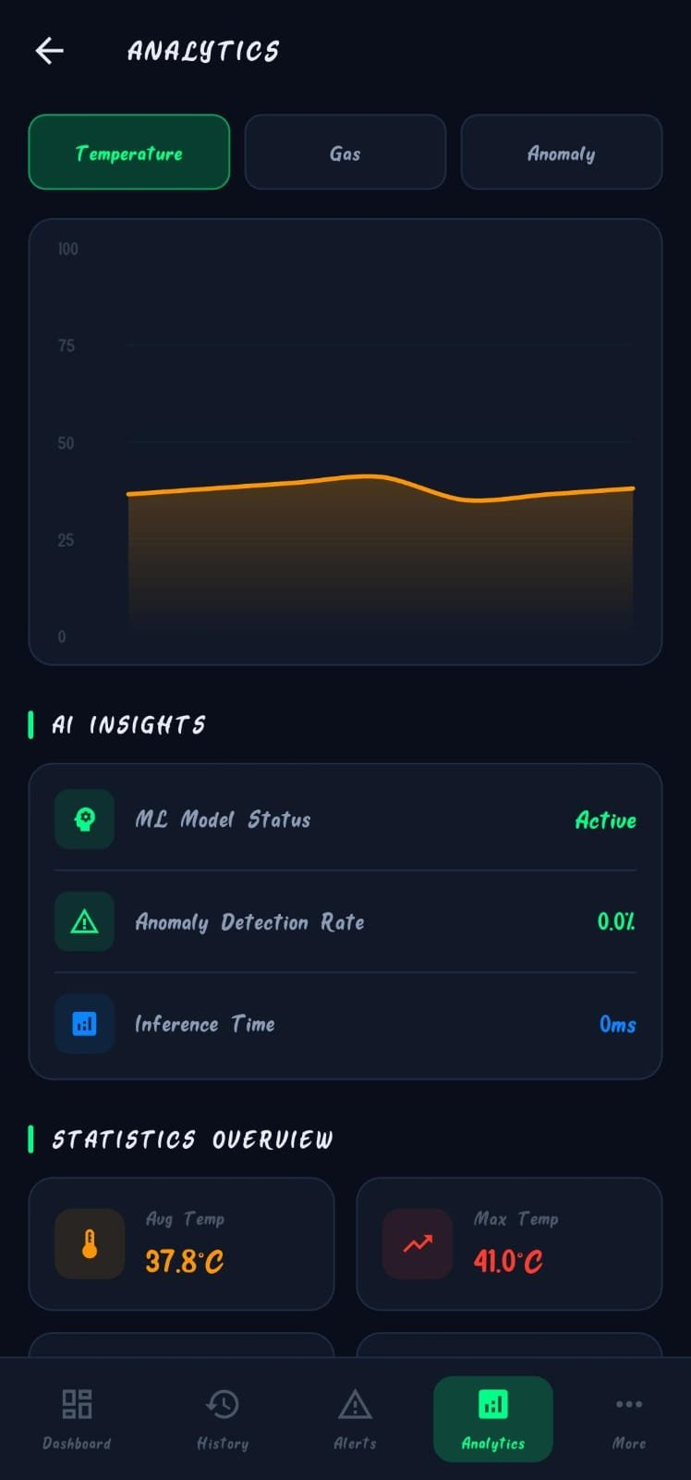
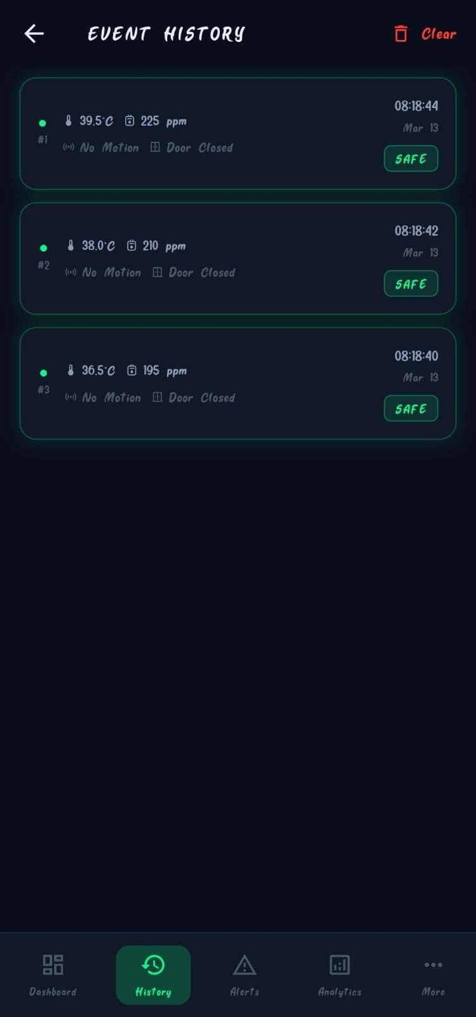
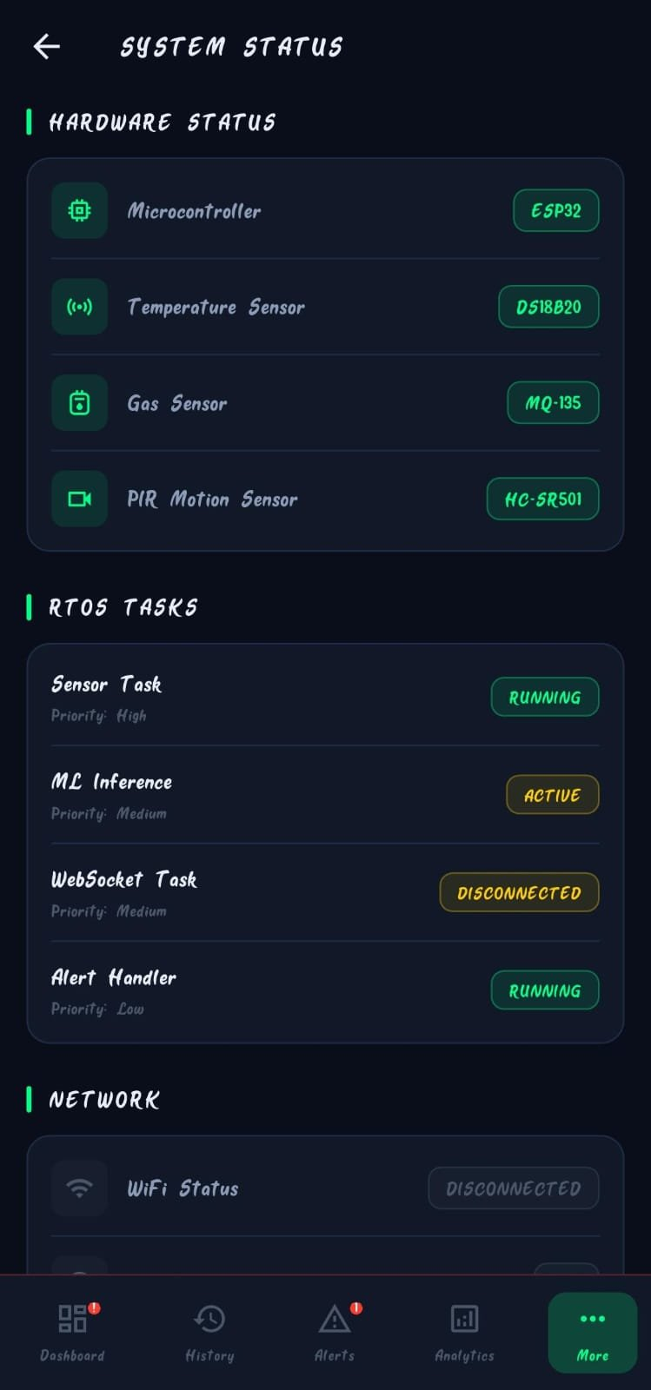
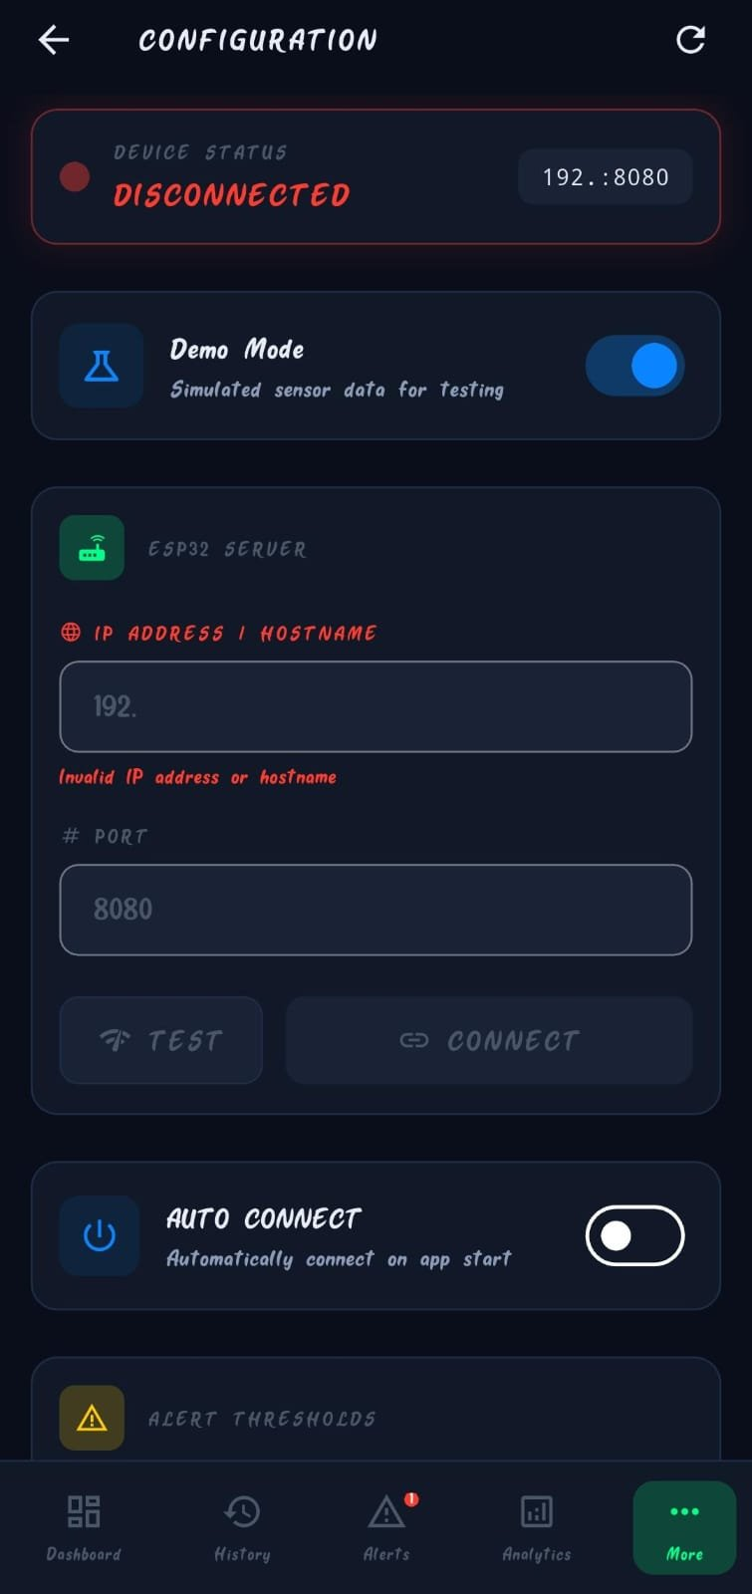
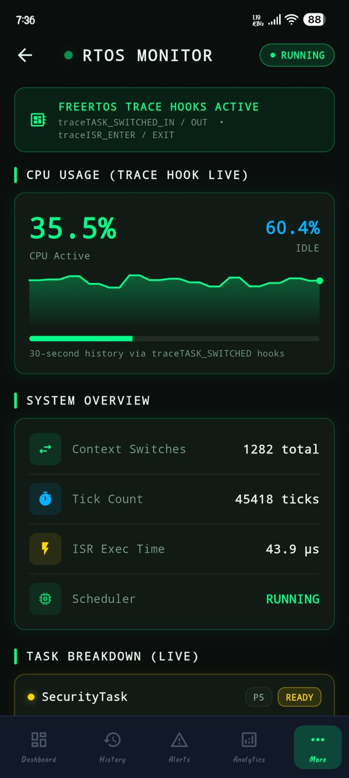
Sample Output — App Screenshots
IndustrialSafe Flutter App — Real-time monitoring interface running on Android
Dashboard
Analytics
Event History
RTOS Live Performance Screen
Configuration
Key Features Demonstrated: Live Gauge | ML Active | Gas Level Bar | RTOS Metrics | AI Insights | Event Log | Task Monitor
Demo Mode with simulated sensor data | WebSocket to ESP32 | Alert threshold configuration

Slide 17
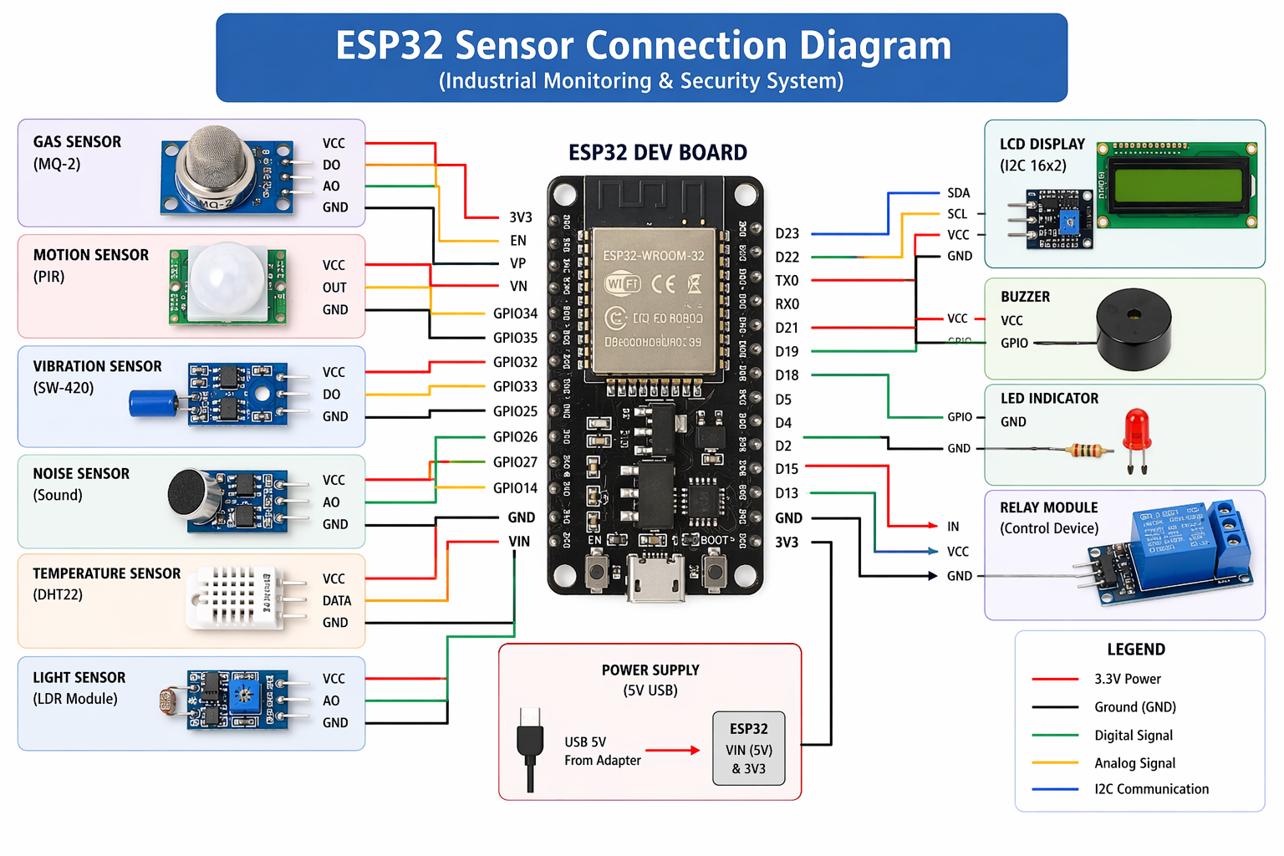
ESP32 CIRCUIT DIAGRAM
Key Features Demonstrated: Live Gauge | ML Active | Gas Level Bar | RTOS Metrics | AI Insights | Event Log | Task Monitor
Demo Mode with simulated sensor data | WebSocket to ESP32 | Alert threshold configuration

Slide 18

System Parameters Analyzed
Task Execution Time (milliseconds)
Task Priority & Scheduling Behavior
CPU Utilization (%)
Communication Latency (ms)
Emergency Response Time
ML-based Anomaly Detection Accuracy (%)

Slide 19
References
[1] Chandrasekaran, M., Saravana Saran, R., Ravishankar, V., and Yasararafath, J. (2025). "RTOS Based Industrial Automation," i-manager's Journal on Embedded Systems, Vol. 3, No. 2, pp. 15-19.
[2] Trivedi,, and Vora (2023). "Real-Time Monitoring and Control System for Industry,"
IJSRD - International Journal for Scientific Research & Development, Vol. 1, Issue 2, pp. 142-147.
[3] Barrett, S.F., Pack, D.J., Straley, C., Sircin, L., and Janack, G. (2023). "Real-Time Operating Systems: A Visual Simulator,"
Proceedings of ASEE Annual Conference and Exposition, pp. 9.1042.1-9.1042.11.
[4] Jose Sistus, M., Manikandan, A., and Janarthanan, M. (2022). "RTOS Based Device Control and Energy Monitoring System,"
International Journal of Advanced Research Trends in Engineering and Technology (IJARTET), Vol. 3, Special Issue 19.
[5] Ahmad, A.B., and Prabowo, S. (2022). "Real Time Operating Systems for Embedded Applications: Design and Implementation,"
Journal of Integrated VLSI, Embedded and Computing Technologies, Vol. 2, No. 1, pp. 37-45.
[6] Chaganty, S.K., Lavan, B., and Prasad, S.S. (2021). "Design & Development of Real-Time Multitasking Microkernel Based on ARM7TDMI,"
International Journal of Instrumentation, Control and Automation (IJICA), Vol. 2, No. 1.
[7] Barry, R. (2016).
Mastering the FreeRTOS™ Real Time Kernel. Real Time Engineers Ltd.
[8] Espressif Systems.
ESP32 Technical Reference Manual. Available: https://www.espressif.com
[9] MQTT Protocol Specification v5.0 – OASIS Standard, 2019.

Slide 20
Thank You

